Slide 1
Plant Seedlings Classification
CX4041 Machine Learning Group Project Video
By: Aaron, Benedict, Ray, Guan Wei

Slide 2
Content
04
Methodologies
K-Nearest Neighbours
Support Vector Machines
Convolutional Neural Network
Ensemble Learning
01
Problem
Introduction
Objective
Kaggle Evaluation Metric
Solution Novelty
05
Transfer Learning
Callbacks
Regularisation
02
Exploratory Analysis
Data Distribution
Size distribution
Histogram Properties
06
Challenges
- Challenges faced
03
Data Preprocessing
Data Augmentation
Image Resizing
Image Masking
07
Conclusion
Recommendations

Slide 3
Problem Statement
Presence of weeds
01
Poses a challenge for the agricultural industry
Compete with crops
02
For valuable resources
Removed late
03
Risk uprooting mature weeds

Slide 4
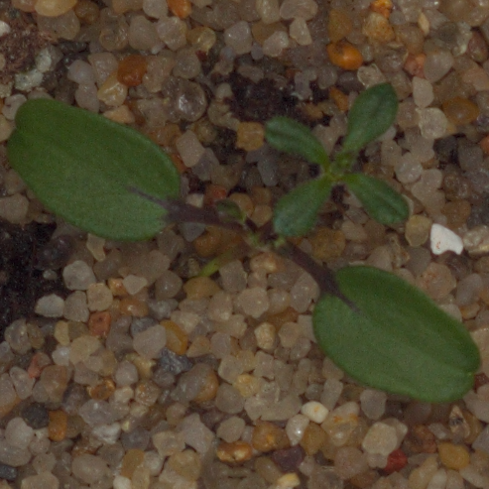
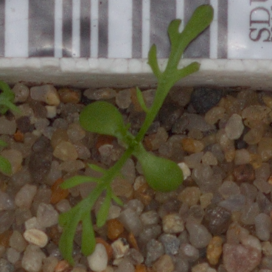
Which is a weed?
VS
Notes:
Weed vs plant images

Slide 5
Problem Statement
Presence of weeds
01
Poses a challenge for the agricultural industry
Compete with crops
02
For valuable resources
Removed late
03
Risk uprooting mature weeds
Not an easy task
04
But essential in classifying seedlings

Slide 6
Project’s Objectives
Optimal learning strategy
Able to classify seedlings
From various approaches carried out
To a high level accuracy

Slide 7
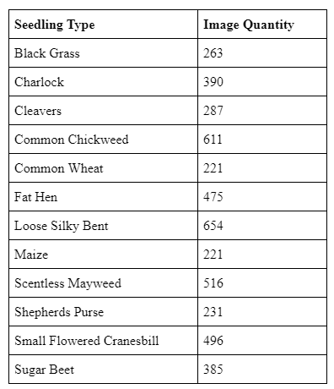
Exploratory data analysis
4750
794
Training Images
Test Images
Table 1: Categories of plant seedlings and number of training images.

Slide 8
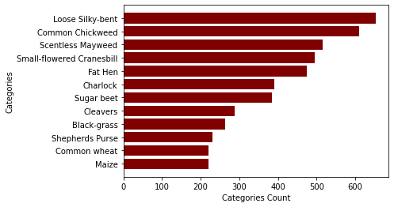
Exploratory data analysis
Figure 1: Data Distribution of Plant Seedlings Categories

Slide 9
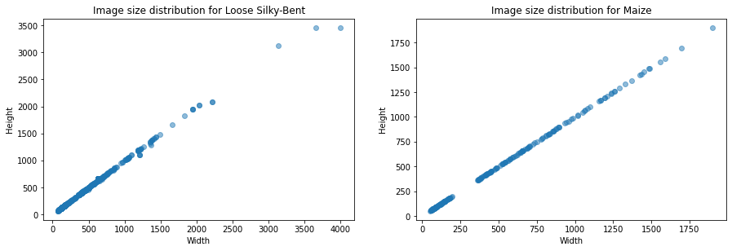
Exploratory data analysis
Figure 2: Image size distribution for 2 different categories

Slide 10
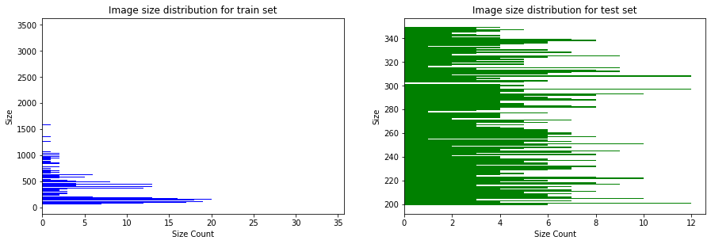
Exploratory data analysis
Figure 3: Image size distribution for train and test sets

Slide 11
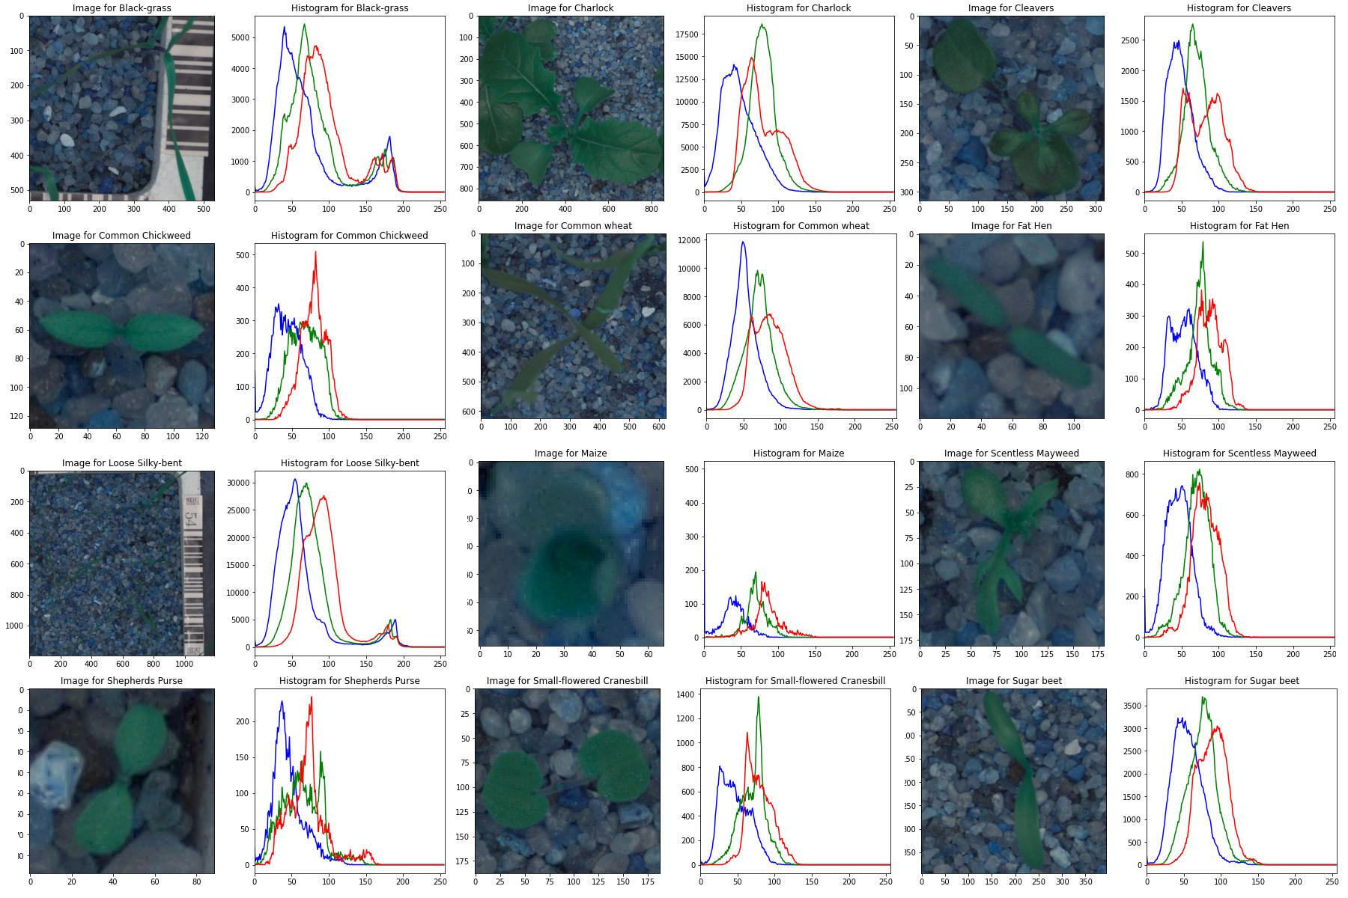
Exploratory data analysis
Figure 4: BGR Histograms of sample image in each category

Slide 12
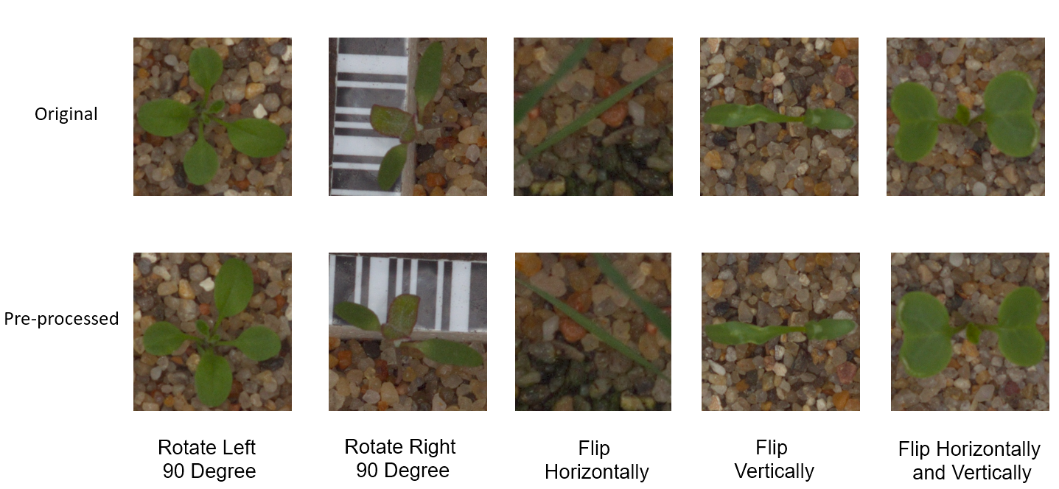
Data Preprocessing
Augmentation
To 1000 images each category
5 different augmentations, randomly chosen
Figure 5: Possible Augmentation Options

Slide 13
Data Preprocessing
Augmentation
Resizing
To 1000 images each category
Resized to 256x256
5 different augmentations, randomly chosen
Sufficient detail retained, less resources used

Slide 14
Data Preprocessing
Augmentation
Resizing
Masking
To 1000 images each category
Resized to 256x256
Remove noise and mask seedling
5 different augmentations, randomly chosen
Sufficient detail retained, less resources used
4 steps

Slide 15
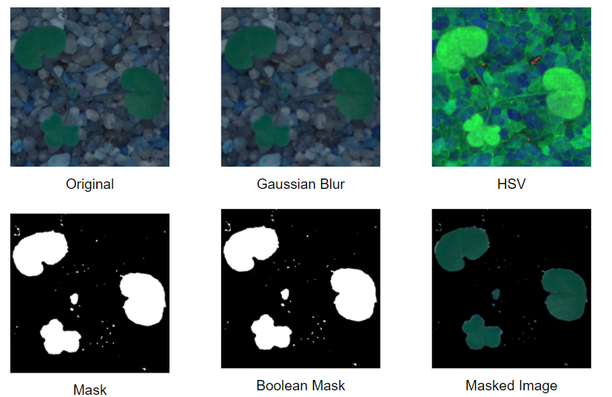
Data Preprocessing
Augmentation
Resizing
Masking
To 1000 images each category
Resized to 256x256
Remove noise and mask seedling
5 different augmentations, randomly chosen
Sufficient detail retained, less resources used
4 steps
Figure 6: Process of Masking

Slide 16
Data Preprocessing
Augmentation
Resizing
Masking
Split
To 1000 images each category
Resized to 256x256
Remove noise and mask seedling
Train validation split of 9:1
5 different augmentations, randomly chosen
Sufficient detail retained, less resources used
4 steps

Slide 17
Methodologies: Traditional Methods

Slide 18
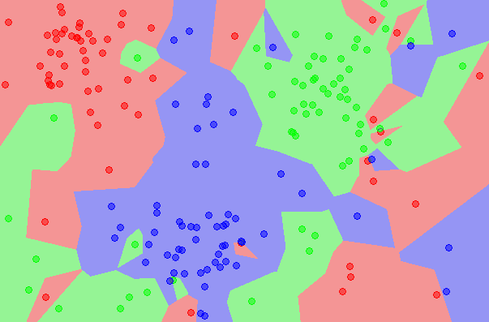
K- Nearest Neighbour
Performs classification by calculating proximity of the data point and neighbours
59.4%
Kaggle Accuracy:

Slide 19
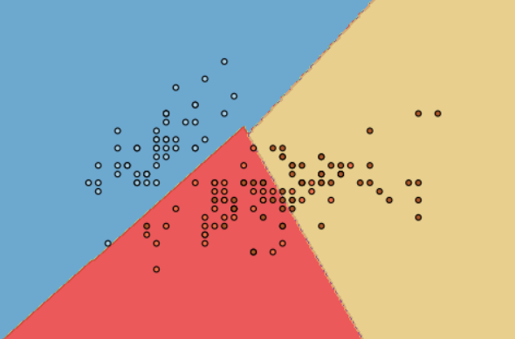
Support Vector Machine
Performs classification by finding optimal hyperplane which maximises margin between different classes
69.0%
Kaggle Accuracy:

Slide 20
Methodologies: Convolutional Neural Networks(CNN)

Slide 21
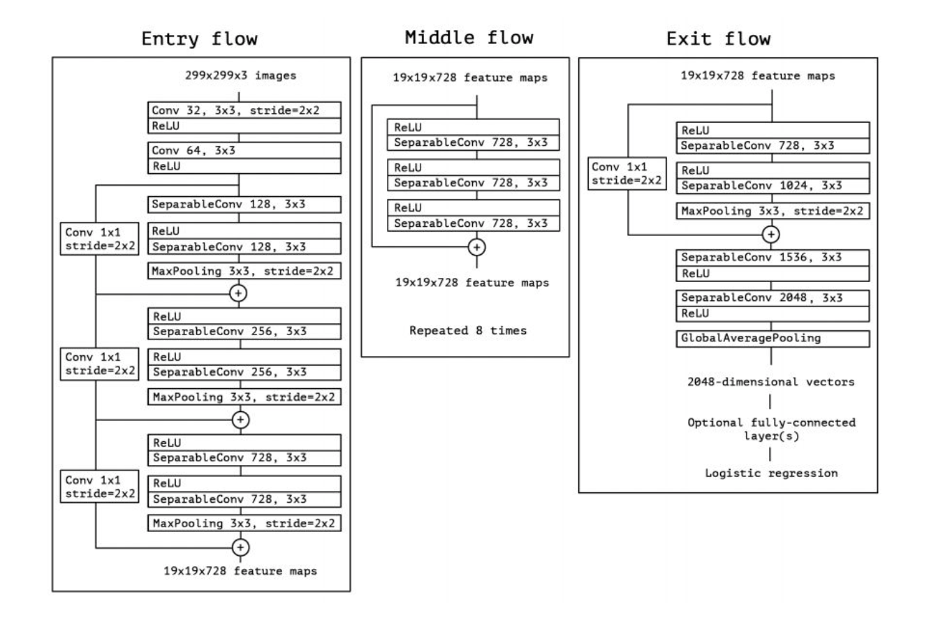
Xception
Extreme implementation of Inception based CNN, with repeated Inception modules running parallel to each other.
96.095%
Kaggle Accuracy:

Slide 22
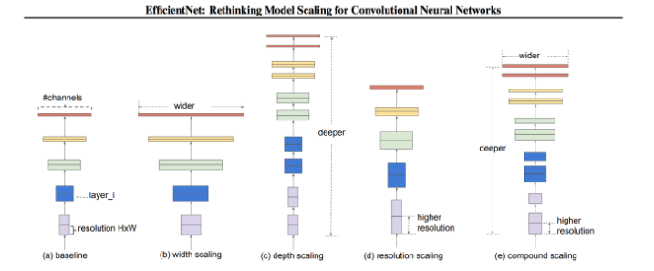
EfficientNetB7
Uses uniformed scaling for the dimensions of depth, width and resolution.
97.103%
Kaggle Accuracy:

Slide 23
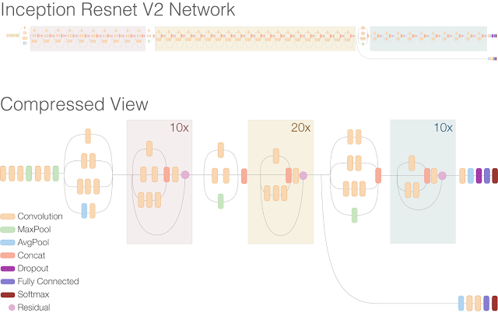
InceptionResNetV2
Hybrid of Inception based CNN that uses ResNet based CNN residual connections between convolutional layers.
97.103%
Kaggle Accuracy:

Slide 24
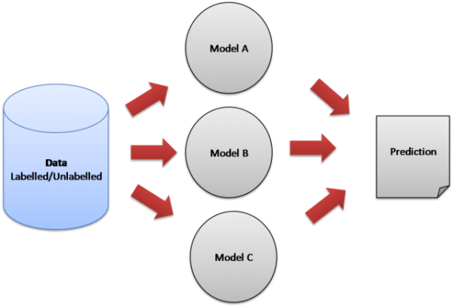
Ensemble Learning
Uses majority voting across 3 different CNN models for predicting the class of an image.
98.362%
Kaggle Accuracy:

Slide 25
Solution Novelty

Slide 26
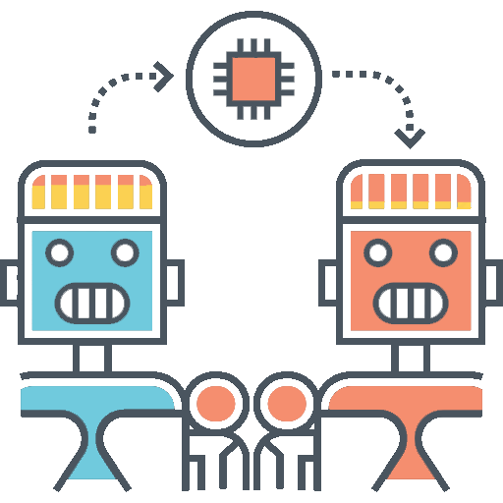
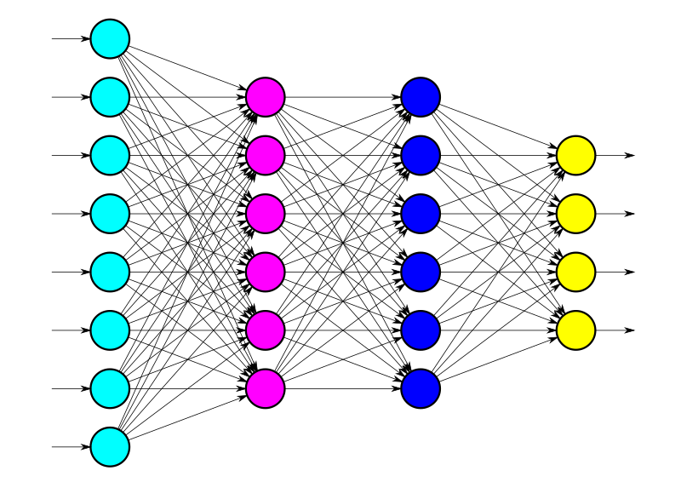
Solution Novelty
Transfer Learning
Our Own Dense Layers
Take advantage of existing pre trained CNN model.
Minimal retraining or tuning required.
Reduced computing time and cost.
Able to learn the features of the plant seedling images specifically.
Not influenced by previously learnt objects of CNN’s original dense layers.

Slide 27

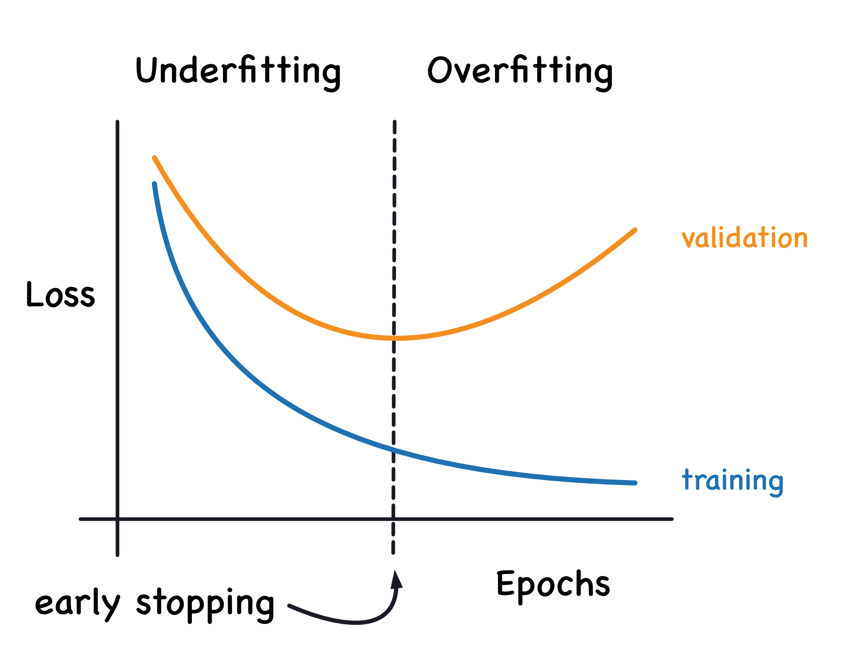
Solution Novelty
Ensemble Learning
Early Stopping
Majority Voting across all CNN models used.
Higher accuracy and performance compared to single CNN.
Based on validation loss metric being monitored.
Prevent overfitting.
Avoid unnecessary epochs.
Reduce computation time and cost.

Slide 28

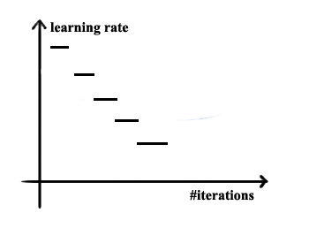
Solution Novelty
Model Checkpoint
Learning Rate Decay
Saves best model weights to disk.
Based on validation loss metric being monitored.
Model weights can be subsequently loaded for testing.
Initial higher learning rate reduces training time.
Reduce learning rate by 5% in every epoch after epoch 5.
Gradually decreasing updates for better convergence towards global minima.

Slide 29
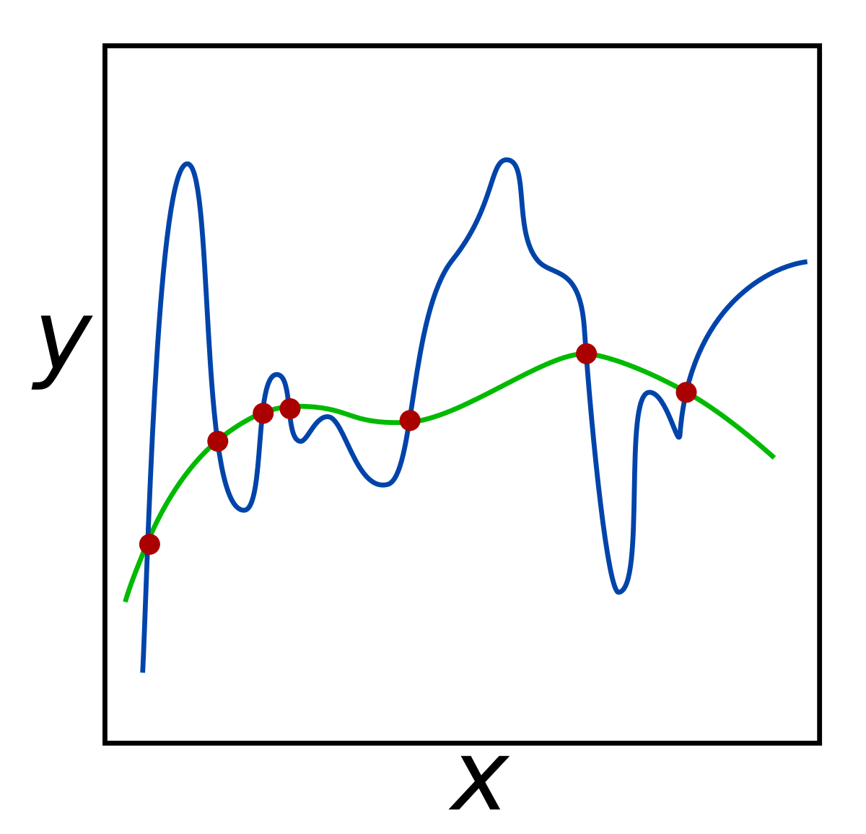
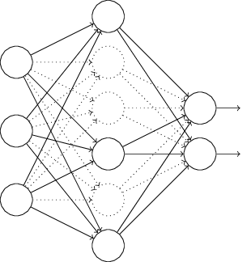
Solution Novelty
Dropouts
Level 2 Regularisation
Disable 50% of neurons during each update.
Non-disabled neurons learn at scaled up rate.
Prevent underfitting or overfitting of specific neurons.
Minimize model complexity.
Reduces weights of neurons by small percentages.
Avoids learning overly complex features.

Slide 30
Challenges
Resized images
Limitations of resources
Saved model checkpoints
Multiple accounts

Slide 31
Conclusion
Leaderboard Scores
Method | Score | Rank
k-Nearest Neighbours | 0.59445 | 758
Support Vector Machine | 0.69017 | 737
Xception | 0.96095 | 383
EfficientNetB7 | 0.97103 | 262
InceptionResNetV2 | 0.97103 | 262
Ensemble Learning | 0.98362 | 77

Slide 32

Conclusion
Near Perfect Accuracy
Neural Networks
Ensemble Learning

Slide 33
Machine Learning Infographics
Artificial Intelligence
Machine learning
Vs
Computers act on their own
They act according to environment
Systems display cognitive ability
Computers make decisions
It’s an application of AI
Computers observe and analyze
Predict based on previous patterns
Pre-programmed algorithms

Slide 34
Machine Learning Infographics
Spam filtering
Mercury is the closest planet to the Sun
Some machine learning applications
Mobile banking
The Earth is the planet where we all live
Risk assessment
Despite being red, Mars is a cold place
Social networks
Jupiter is the biggest planet of them all

Slide 35
Machine Learning Infographics
01
02
Venus
Mercury
Venus has a beautiful name, but it’s hot
Mercury is the closest planet to the Sun

Slide 36
Machine Learning Infographics
01
02
Mercury
Venus
Mercury is the closest planet to the Sun
Machine learning
Venus has a beautiful name, but it’s hot
Yes, Saturn is a gas giant that has several rings
03
04
Earth
Mars
The Earth is the third planet from the Sun
Despite being red, Mars is a cold place

Slide 37
Machine Learning Infographics
Machine learning
Mars
04
Saturn is the gas giant that has rings
Despite being red, Mars is a cold place
Venus
03
Venus has a beautiful name, but it’s hot
Mercury
02
Mercury is the closest planet to the Sun
Earth
01
The Earth is the third planet from the Sun

Slide 38
Machine Learning Infographics
01
Power
AI
Memory
02
Mercury is the closest planet to the Sun
Neptune is the farthest planet from the Sun
System configuration
03
Memory
Mars
04
Jupiter is a gas giant and the biggest planet
Despite being red, Mars is a cold place
05
Security
FPGA
06
Venus has a beautiful name, but it’s hot
Pluto is considered a dwarf planet
07
MCU
Wireless
08
The Earth is the third planet from the Sun
Ceres is located in the main asteroid belt

Slide 39
Machine Learning Infographics
Artificial intelligence
Mercury is the closest planet to the Sun
Machine learning
Jupiter is a gas giant and the biggest planet
Deep learning
Venus has a beautiful name, but it’s hot

Slide 40
Machine Learning Infographics
Output unit
Neural network
Yes, Saturn is a gas giant that has rings
01
Output layer
02
Input layer
Input unit 1
Input unit 2

Slide 41
Machine Learning Infographics
01
02
03
04
1950s
1960s
1970s
1980s
Simple algorithms
Bayesian methods
AI winter caused by pessimism
Resurgence in ML research
Mercury is the closest planet to the Sun
Jupiter is a gas giant and the biggest planet
Venus has a beautiful name, but it’s very hot
Mercury is the closest planet to the Sun
05
06
07
1990s
2000s
2010s
Data-driven approach
Support-Vector Clustering
Deep learning popularity
The Earth is the third planet from the Sun
Ceres is located in the main asteroid belt
Venus has a beautiful name, but it’s very hot

Slide 42
Machine Learning Infographics
Continuous improvement
Machine learning disadvantages
01
Despite being red, Mars is a cold place
Data acquisition
02
Venus has a beautiful name, but it’s hot
Patterns identification
03
Mercury is the closest planet to the Sun
Time and resources
04
The Earth is the third planet from the Sun

Slide 43
Machine Learning Infographics
01
02
Image recognition
Customization
The Earth is the planet where we live
Despite being red, Mars is a cold place
03
04
Voice recognition
Opportunities of machine learning
Data analysis
Venus has a beautiful name, but it’s hot
The Earth is the third planet from the Sun
05
06
Optical recognition
Memory data
Mercury is the closest planet to the Sun
Pluto is considered a dwarf planet

Slide 44
Machine Learning Infographics
Machine learning
The model
Venus has a beautiful name, but it’s hot
Despite being red, Mars is a cold place
Input 1
Input 2
The Earth is the third planet from the Sun
Mercury is the closest planet to the Sun

Slide 45
Machine Learning Infographics
01 | Supervised learning
 | Venus has a beautiful name, but it’s hot
02 | Unsupervised learning
 | Despite being red, Mars is a cold place
03 | Semi-supervised learning
 | The Earth is the third planet from the Sun
04 | Reinforcement learning
 | Mercury is the closest planet to the Sun
05 | Dimensionality reduction
 | Pluto is considered a dwarf planet

Slide 46
Machine Learning Infographics
01
Active learning
Maturation
02
Mercury is the closest planet to the Sun
Jupiter is a gas giant and the biggest planet
03
Motor synergies
Imitation
04
The Earth is the planet where we live
Despite being red, Mars is a cold place

Slide 47
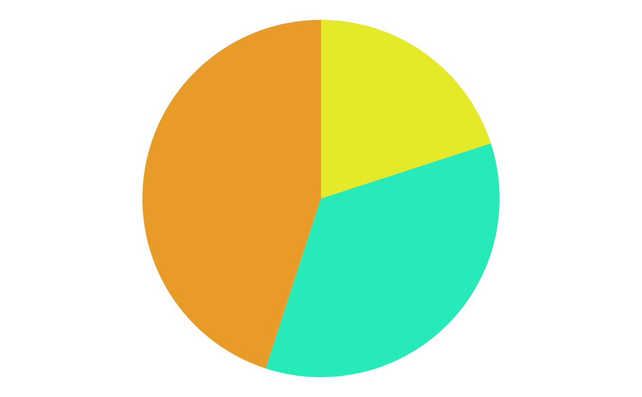
Machine Learning Infographics
45%
20%
Data mining
Intrusion detection
The Earth is the third planet from the Sun
Mercury is the closest planet to the Sun
35%
Continuous production
Despite being red, Mars is a very cold place
Follow the link in the graph to modify its data and then paste the new one here. For more info, click here

Slide 48
Machine Learning Infographics
01
Classify data
Mercury is the closest planet to the Sun
Machine learning objectives
02
Make predictions
The Earth is the planet where we live

Slide 49
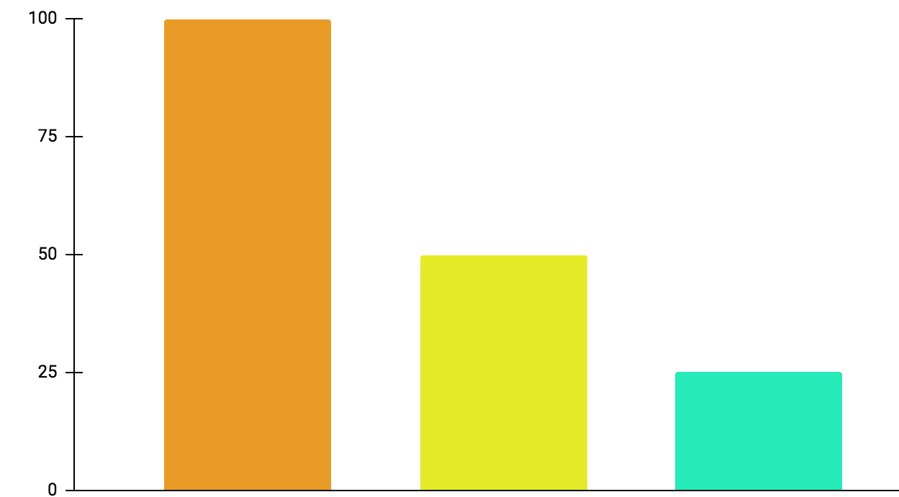
Machine Learning Infographics
01
Active learning
Mercury is the closest planet to the Sun
02
Maturation
Jupiter is a gas giant and the biggest planet
03
Motor synergies
Neptune is very far away from the Sun
100%
50%
25%
Follow the link in the graph to modify its data and then paste the new one here. For more info, click here

Slide 50
Machine Learning Infographics
Models
Artificial neural networks | The Earth is the planet we live on
Decision trees | Mercury is the smallest planet
Support-vector machines | Despite being red, Mars is a cold place
Regression analysis | Jupiter is the biggest planet of them all
Bayesian networks | Venus has a beautiful name
Genetic algorithms | Pluto is considered a dwarf planet

Slide 51
Machine Learning Infographics
Collect the data
Prepare the data
Mercury is the closest planet to the Sun
The Earth is the third planet from the Sun
Train a model
Despite being red, Mars is a cold place
Improve
Evaluate the model
Pluto is considered a dwarf planet
Jupiter is the biggest planet of them all

Slide 52
Machine Learning Infographics
Inputs
Outputs
Mercury is the closest planet to the Sun
Jupiter is a gas giant and the biggest planet
Input 1
Output 1
Input 2
Output 2
Input 3
Output 3

Slide 53
Machine Learning Infographics
Supervised learning
Unsupervised learning
Reinforcement learning
Classification
Reduction
Fraud detection
Email spam detection
Diagnostics
Image classification
Text mining
Data visualization
Face detection
Voice detection
Finances
Manufacturing
Stock management
Autonomous cars
Regression
Regression
Risk assessment
Score prediction
City planning
Targeted marketing

Slide 54
Machine Learning Infographics
Predict trends
01
02
Innovation
Venus has a beautiful name, but it’s hot
Despite being red, Mars is a cold place
Target segmentation
03
Cost reduction
04
Mercury is the closest planet to the Sun
Neptune is very far away from the Sun
Advert segmentation
05
06
Customer relations
ML for business
The Earth is the third planet from the Sun
Jupiter is the biggest planet of them all

Slide 55
Machine Learning Infographics
Machine learning application example
Polite
Offensive
01
02
03
04
Tweet
Feature engineering
Classification
Output
Mercury is the closest planet to the Sun
Venus has a beautiful name, but it’s hot
The Earth is the third planet from the Sun
Despite being red, Mars is a cold place

Slide 56
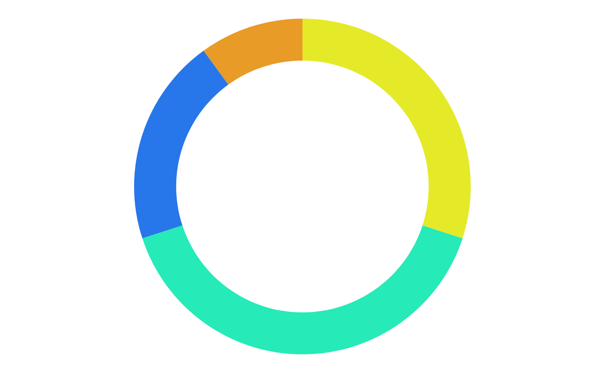
Machine Learning Infographics
10%
30%
Mercury
Jupiter
Mercury is the closest planet to the Sun
Jupiter is a gas giant and the biggest planet
20%
40%
Neptune
Mars
It’s the farthest planet from the Sun
Despite being red, Mars is a cold place
Follow the link in the graph to modify its data and then paste the new one here. For more info, click here

Slide 57
Machine Learning Infographics
Biochemical analysis
Disease diagnosis
Drug discovery
Mercury is the closest planet to the Sun
Venus has a beautiful name, but it’s hot
The Earth is the third planet from the Sun

Slide 58
Machine Learning Infographics
 | Common Uses for Machine Learning
01 | Chatbot systems | Venus has a beautiful name, but it’s hot
02 | Decision support | Mercury is the closest planet to the Sun
03 | Customer recommendation engines | The Earth is the third planet from the Sun
04 | Customer churn modeling | Despite being red, Mars is a cold place
05 | Pricing strategies | Neptune is the farthest planet from the Sun
06 | Customer segmentation | Jupiter is the biggest planet of them all
07 | Image classification | Pluto is now considered a dwarf planet

Slide 59
Machine Learning Infographics
Input data
Neptune
Mars
It’s the farthest planet from the Sun
Despite being red, Mars is a cold place
Learning system
Mercury is the closest planet to the Sun
Output data

Slide 60
Machine Learning Infographics
Machine learning advantages vs disadvantages
Advantages
Disadvantages
Efficiency data managing
Continuous improvement
Lots of applications
Trend identification
Pattern identification
Data acquisition
Time and space
Time-consuming
High error possibilities
Algorithm selection

Slide 61
Machine Learning Infographics
01
02
03
Identify data
Choose algorithm
Analytical model
Venus has a beautiful name, but it’s hot
Mercury is the closest planet to the Sun
Despite being red, Mars is a cold place
04
05
Train the model
Run the model
Jupiter is the biggest planet of them all
Neptune is very far away from the Sun

Slide 62
Machine Learning Infographics
Input data
Jupiter is the biggest planet of them all
Relationships
Patterns
Machine learning
Algorithms + techniques
Dependencies
Structures
Output
Despite being red, Mars is a cold place

